Slide 1
Chapter 18 Recursion

Slide 2
Motivations
Suppose you want to find all the files under a directory that contains a particular word. How do you solve this problem? There are several ways to solve this problem. An intuitive solution is to use recursion by searching the files in the subdirectories recursively.

Slide 3
Characteristics of Recursion
All recursive methods have the following characteristics:
  One or more base cases (the simplest case) are used to stop recursion.
  Every recursive call reduces the original problem, bringing it increasingly closer to a base case until it becomes that case.
In general, to solve a problem using recursion, you break it into subproblems. If a subproblem resembles the original problem, you can apply the same approach to solve the subproblem recursively. This subproblem is almost the same as the original problem in nature with a smaller size.

Slide 4
Problem Solving Using Recursion
Let us consider a simple problem of printing a message for n times. You can break the problem into two subproblems: one is to print the message one time and the other is to print the message for n-1 times. The second problem is the same as the original problem with a smaller size. The base case for the problem is n==0. You can solve this problem using recursion as follows:
nPrintln(“Welcome“, 5);
public static void nPrintln(String message, int times) {
if (times >= 1) {
System.out.println(message);
nPrintln(message, times - 1);
} // The base case is times == 0
}

Slide 5
Think Recursively
Many of the problems presented in the early chapters can be solved using recursion if you think recursively. For example, the palindrome problem can be solved recursively as follows:
public static boolean isPalindrome(String s) {
if (s.length() <= 1) // Base case
return true;
else if (s.charAt(0) != s.charAt(s.length() - 1)) // Base case
return false;
else
return isPalindrome(s.substring(1, s.length() - 1));
}

Slide 6
Recursive Helper Methods
The preceding recursive isPalindrome method is not efficient, because it creates a new string for every recursive call. To avoid creating new strings, use a helper method:
public static boolean isPalindrome(String s) {
return isPalindrome(s, 0, s.length() - 1);
}
public static boolean isPalindrome(String s, int low, int high) {
if (high <= low) // Base case
return true;
else if (s.charAt(low) != s.charAt(high)) // Base case
return false;
else
return isPalindrome(s, low + 1, high - 1);
}

Slide 7
Computing Factorial
factorial(0) = 1;
factorial(n) = n*factorial(n-1);
n! = n * (n-1)!

Slide 8
Computing Factorial
animation
factorial(0) = 1;
factorial(n) = n*factorial(n-1);
factorial(4)

Slide 9
Computing Factorial
animation
factorial(0) = 1;
factorial(n) = n*factorial(n-1);
factorial(4) = 4 * factorial(3)

Slide 10
Computing Factorial
animation
factorial(0) = 1;
factorial(n) = n*factorial(n-1);
factorial(4) = 4 * factorial(3)
= 4 * 3 * factorial(2)

Slide 11
Computing Factorial
animation
factorial(0) = 1;
factorial(n) = n*factorial(n-1);
factorial(4) = 4 * factorial(3)
= 4 * 3 * factorial(2)
= 4 * 3 * (2 * factorial(1))

Slide 12
Computing Factorial
animation
factorial(0) = 1;
factorial(n) = n*factorial(n-1);
factorial(4) = 4 * factorial(3)
= 4 * 3 * factorial(2)
= 4 * 3 * (2 * factorial(1))
= 4 * 3 * ( 2 * (1 * factorial(0)))

Slide 13
Computing Factorial
animation
factorial(0) = 1;
factorial(n) = n*factorial(n-1);
factorial(4) = 4 * factorial(3)
= 4 * 3 * factorial(2)
= 4 * 3 * (2 * factorial(1))
= 4 * 3 * ( 2 * (1 * factorial(0)))
= 4 * 3 * ( 2 * ( 1 * 1)))

Slide 14
Computing Factorial
animation
factorial(0) = 1;
factorial(n) = n*factorial(n-1);
factorial(4) = 4 * factorial(3)
= 4 * 3 * factorial(2)
= 4 * 3 * (2 * factorial(1))
= 4 * 3 * ( 2 * (1 * factorial(0)))
= 4 * 3 * ( 2 * ( 1 * 1)))
= 4 * 3 * ( 2 * 1)

Slide 15
Computing Factorial
animation
factorial(0) = 1;
factorial(n) = n*factorial(n-1);
factorial(4) = 4 * factorial(3)
= 4 * 3 * factorial(2)
= 4 * 3 * (2 * factorial(1))
= 4 * 3 * ( 2 * (1 * factorial(0)))
= 4 * 3 * ( 2 * ( 1 * 1)))
= 4 * 3 * ( 2 * 1)
= 4 * 3 * 2

Slide 16
Computing Factorial
animation
factorial(0) = 1;
factorial(n) = n*factorial(n-1);
factorial(4) = 4 * factorial(3)
= 4 * 3 * factorial(2)
= 4 * 3 * (2 * factorial(1))
= 4 * 3 * ( 2 * (1 * factorial(0)))
= 4 * 3 * ( 2 * ( 1 * 1)))
= 4 * 3 * ( 2 * 1)
= 4 * 3 * 2
= 4 * 6

Slide 17
Computing Factorial
animation
factorial(0) = 1;
factorial(n) = n*factorial(n-1);
factorial(4) = 4 * factorial(3)
= 4 * 3 * factorial(2)
= 4 * 3 * (2 * factorial(1))
= 4 * 3 * ( 2 * (1 * factorial(0)))
= 4 * 3 * ( 2 * ( 1 * 1)))
= 4 * 3 * ( 2 * 1)
= 4 * 3 * 2
= 4 * 6
= 24

Slide 18


Trace Recursive factorial
animation
Executes factorial(4)

Slide 19
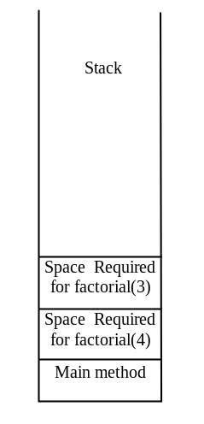
Trace Recursive factorial
animation
Executes factorial(3)

Slide 20
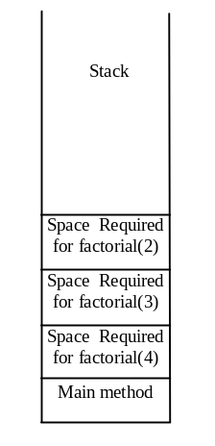
Trace Recursive factorial
animation
Executes factorial(2)

Slide 21
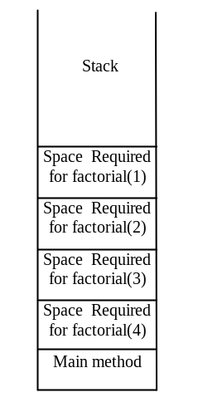
Trace Recursive factorial
animation
Executes factorial(1)

Slide 22
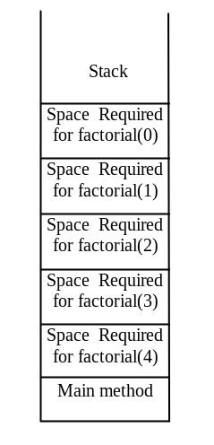
Trace Recursive factorial
animation
Executes factorial(0)

Slide 23
Trace Recursive factorial
animation
returns 1

Slide 24
Trace Recursive factorial
animation
returns factorial(0)

Slide 25
Trace Recursive factorial
animation
returns factorial(1)

Slide 26

Trace Recursive factorial
animation
returns factorial(2)

Slide 27
Trace Recursive factorial
animation
returns factorial(3)

Slide 28
Trace Recursive factorial
animation
returns factorial(4)

Slide 29
Other Examples
f(0) = 0;
f(n) = n + f(n-1);

Slide 30
Fibonacci Numbers
Fibonacci series: 0 1 1 2 3 5 8 13 21 34 55 89…
indices: 0 1 2 3 4 5 6 7 8 9 10 11
fib(0) = 0;
fib(1) = 1;
fib(index) = fib(index -1) + fib(index -2); index >=2
fib(3) = fib(2) + fib(1) = (fib(1) + fib(0)) + fib(1) = (1 + 0) +fib(1) = 1 + fib(1) = 1 + 1 = 2

Slide 31

Fibonnaci Numbers, cont.

Slide 32
Recursive Implementation
/** Use binary search to find the key in the list */
public static int recursiveBinarySearch(int[] list, int key) {
int low = 0;
int high = list.length - 1;
return recursiveBinarySearch(list, key, low, high);
}
/** Use binary search to find the key in the list between
list[low] list[high] */
public static int recursiveBinarySearch(int[] list, int key,
int low, int high) {
if (low > high) // The list has been exhausted without a match
return -low - 1;
int mid = (low + high) / 2;
if (key < list[mid])
return recursiveBinarySearch(list, key, low, mid - 1);
else if (key == list[mid])
return mid;
else
return recursiveBinarySearch(list, key, mid + 1, high);
}

Slide 33
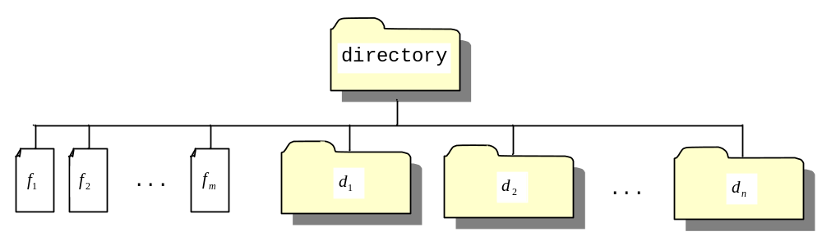
Directory Size
The preceding examples can easily be solved without using recursion. This section presents a problem that is difficult to solve without using recursion. The problem is to find the size of a directory. The size of a directory is the sum of the sizes of all files in the directory. A directory may contain subdirectories. Suppose a directory contains files , , ..., , and subdirectories , , ..., , as shown below.

Slide 34
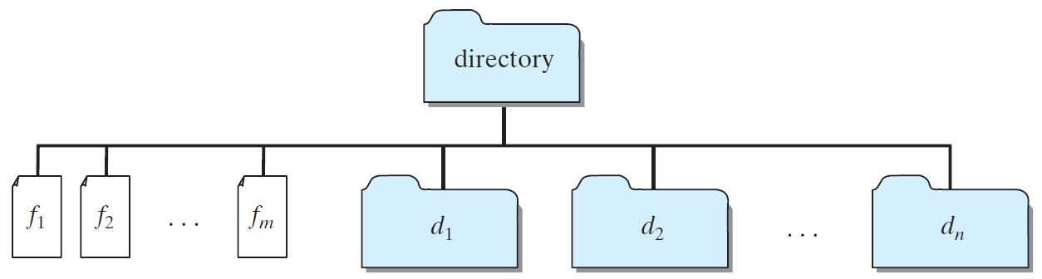
Directory Size
The size of the directory can be defined recursively as follows:

Slide 35
Tower of Hanoi
There are n disks labeled 1, 2, 3, . . ., n, and three towers labeled A, B, and C.
No disk can be on top of a smaller disk at any time.
All the disks are initially placed on tower A.
Only one disk can be moved at a time, and it must be the top disk on the tower.

Slide 36
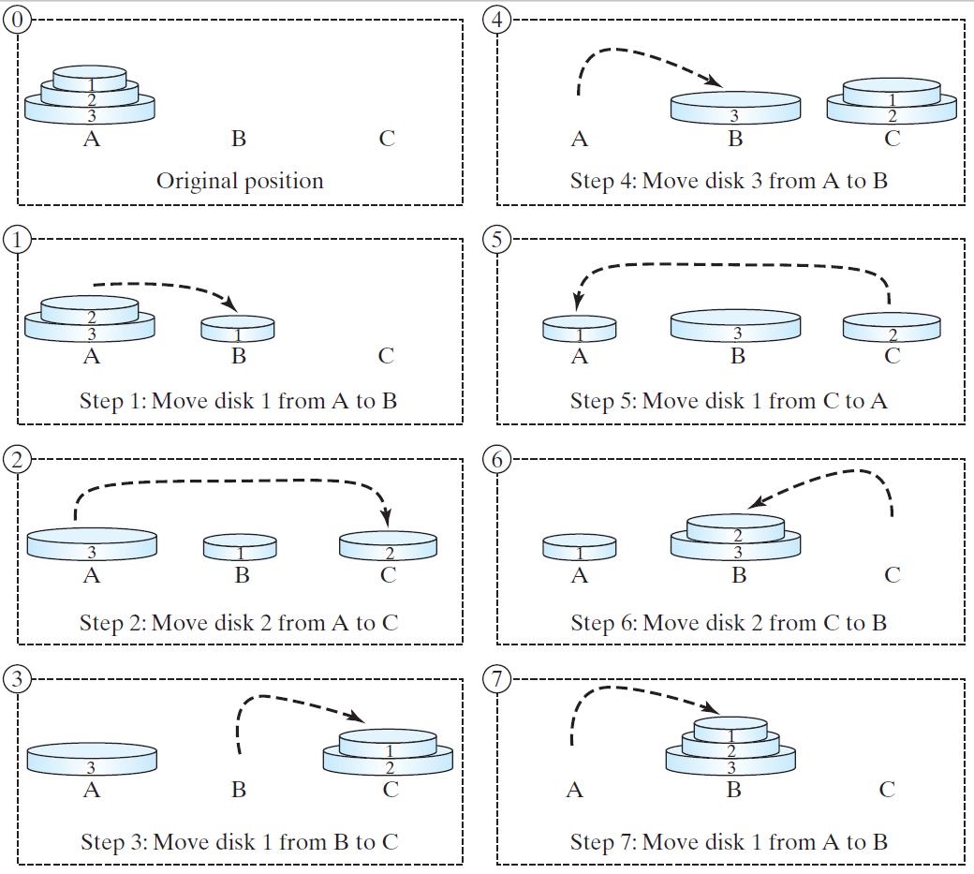
Tower of Hanoi, cont.

Slide 37
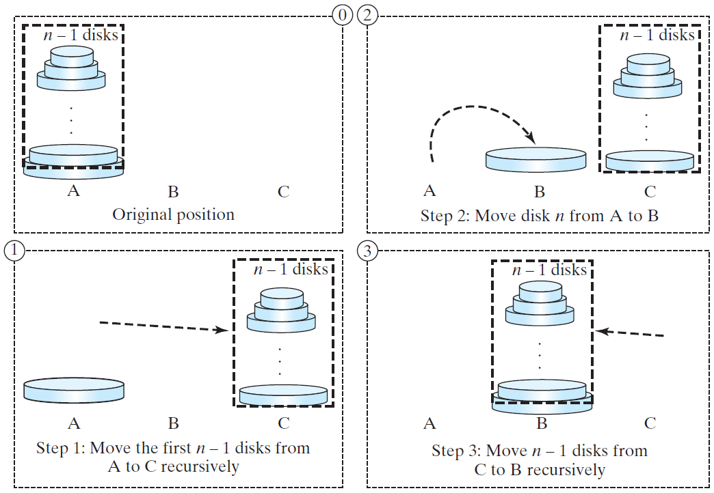
Solution to Tower of Hanoi
The Tower of Hanoi problem can be decomposed into three subproblems.

Slide 38
Solution to Tower of Hanoi
Move the first n - 1 disks from A to C with the assistance of tower B.
Move disk n from A to B.
Move n - 1 disks from C to B with the assistance of tower A.

Slide 39
Exercise 18.3 GCD
gcd(2, 3) = 1
gcd(2, 10) = 2
gcd(25, 35) = 5
gcd(205, 301) = 5
gcd(m, n)
Approach 1: Brute-force, start from min(n, m) down to 1, to check if a number is common divisor for both m and n, if so, it is the greatest common divisor.
Approach 2: Euclid’s algorithm
Approach 3: Recursive method

Slide 40
Approach 2: Euclid’s algorithm
// Get absolute value of m and n;
t1 = Math.abs(m); t2 = Math.abs(n);
// r is the remainder of t1 divided by t2;
r = t1 % t2;
while (r != 0) {
t1 = t2;
t2 = r;
r = t1 % t2;
}
// When r is 0, t2 is the greatest common
// divisor between t1 and t2
return t2;

Slide 41
Approach 3: Recursive Method
gcd(m, n) = n if m % n = 0;
gcd(m, n) = gcd(n, m % n); otherwise;

Slide 42
Recursion vs. Iteration
Recursion is an alternative form of program control. It is essentially repetition without a loop.
Recursion bears substantial overhead. Each time the program calls a method, the system must assign space for all of the method’s local variables and parameters. This can consume considerable memory and requires extra time to manage the additional space.

Slide 43
Advantages of Using Recursion
Recursion is good for solving the problems that are inherently recursive.

